Slide 1
Predicting Free and Reduced Lunch Eligibility in US Public Schools
Parasmai Salunkhe, Lucas Libelo
Period 3, Dr. Yilmaz

Slide 2
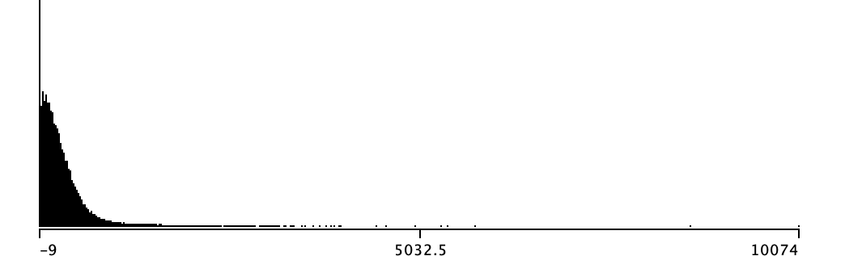
Our Dataset
Contains 101390 instances, dimensions 74
administrative and fiscal data about all public schools, school districts, and state education agencies in the United States
Contains special values : -1 or M indicates missing values and -2 or N indicates the data is not applicable. -9 indicates that the data does not meet NCES standards.
Heavily skewed due to the right
USDA income eligibility
Notes:
Lucas

Slide 3
Goal of Classification
Aid in the allocation of financial and dietary resources to schools who need them most
Predict the number of students that are eligible for free and reduced-price lunch.
Class attribute (TOTFRL) which has the number of students on a reduced lunch program) is numeric and discrete.
Split class data into two groups: low (below average) and high (above average)

Slide 4
Preprocessing
removed all instances with missing class labels, leaving us with a total of 86,637 instances
We used Weka’s remove SubsetByExpression with the expression “not ismissing(ATT#)” to remove attributes with missing class labels
Removed unnecessary attributes: OBJECTID, NCESSCH, SURVYEAR, STABR, LEAID, ST_LEAID, LEA_NAME, SCH_NAME, LSTREET1, LSTREET2, PHONE, LATCOD, and LONCOD
Removed all attributes that had missing values greater than 45% (PK, KG, G01-G13, AE, GSLO, GSHI, LZIP4, DIRECTCERT, and UG)
Three special values: (-1 missing, -2 or N not applicable, -9 didn’t meet surveyor requirements)
Removed with google sheets using replace tool
Treated as missing

Slide 5
More Preprocessing
Class Data (TOTFRL) discrete and numeric
split the class data into two groups:
-low, meaning that the number of students eligible for free or reduced-price lunch is below average
high, meaning that the number of students eligible for free or reduced-price lunch is above average
Used Weka’s discretize filter with equal frequency binning
Notes:
lucas

Slide 6
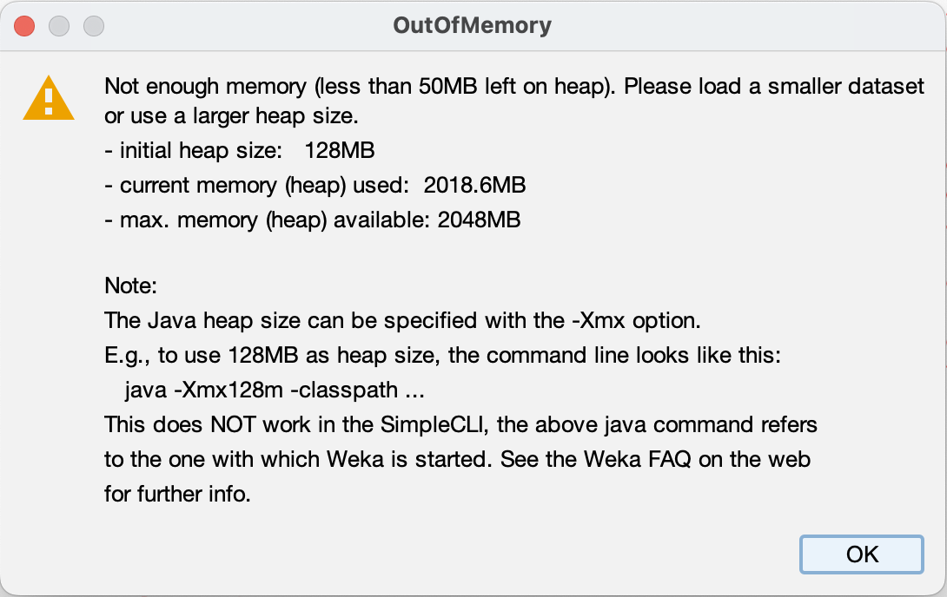
Pre-Training
Memory Constraint because Dataset too large
The nature of our class labels (high being above average and low being below average) lead to a perfect 50/50 split of instances among these two possible labels
Used simple random sampling to produce a sample with a distribution of classes that is equal to the distribution of the original dataset
Notes:
lucas

Slide 7
Train/Test split
70% of the data as a training set, 30% of the data as a test set.
We split this test set in two, using 15% of our dataset as a validation set, and using another 15% of our dataset (the other half of the test set) as a final test set
Used Weka’s RemovePercentage filter to split the dataset into training and testing sets and to split the testing set into testing and validation sets.
We ensured that the split datasets did not overlap by using each percentage once with and once without the InvertSelection field as true.
Notes:
parasmai

Slide 8
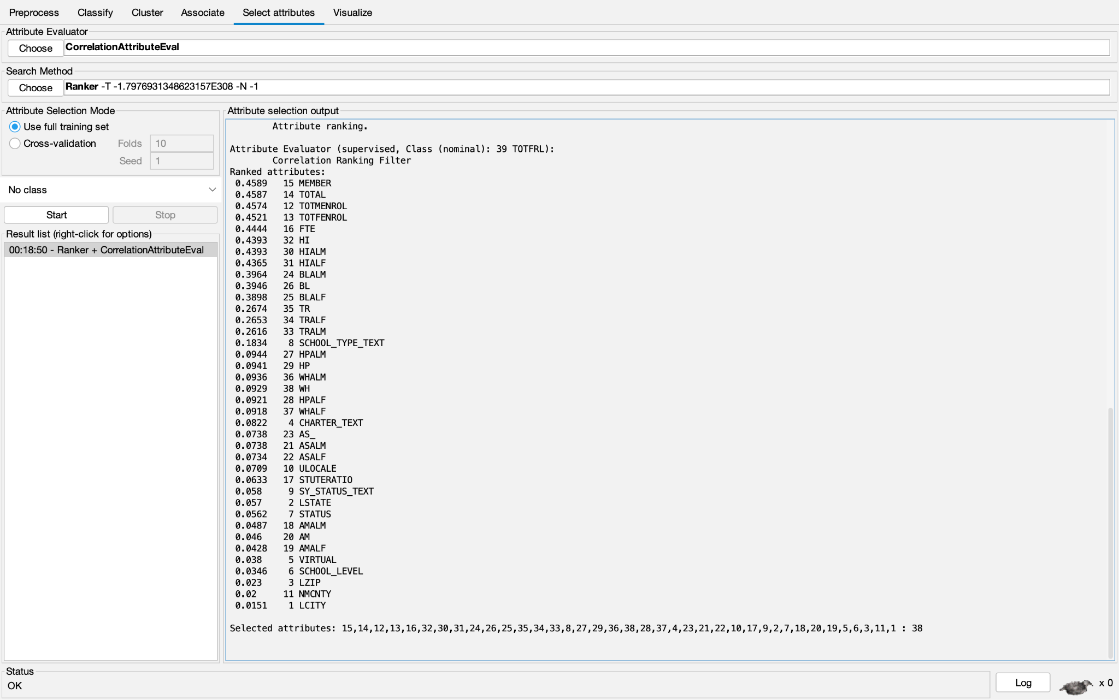
Attribute Selection - Correlation
We used Weka’s correlation attribute evaluator with the ranker search method. The results were as follows. We used a cutoff value of 0.2;
the attributes we removed were: SCHOOL_TYPE_TEXT, HPALM, HP, WHALM, WH, HPALF, WHALF, CHARTER_TEXT, AS_, ASALM, ASALF, ULOCALE, STUTERATIO, SY_STATUS_TEXT, LSTATE, STATUS, AMALM, AM, AMALF, VIRTUAL, SCHOOL_LEVEL, LZIP, NMCNTY, and LCITY.
The attributes with a correlation greater than 0.2 were: MEMBER, TOTAL, TOTMENROL, TOTFENROL, FTE, HI, HIALM, HIALF, BLALM, BL, BLALF, TR, TRALF, and TRALM.
Notes:
parasmai

Slide 9
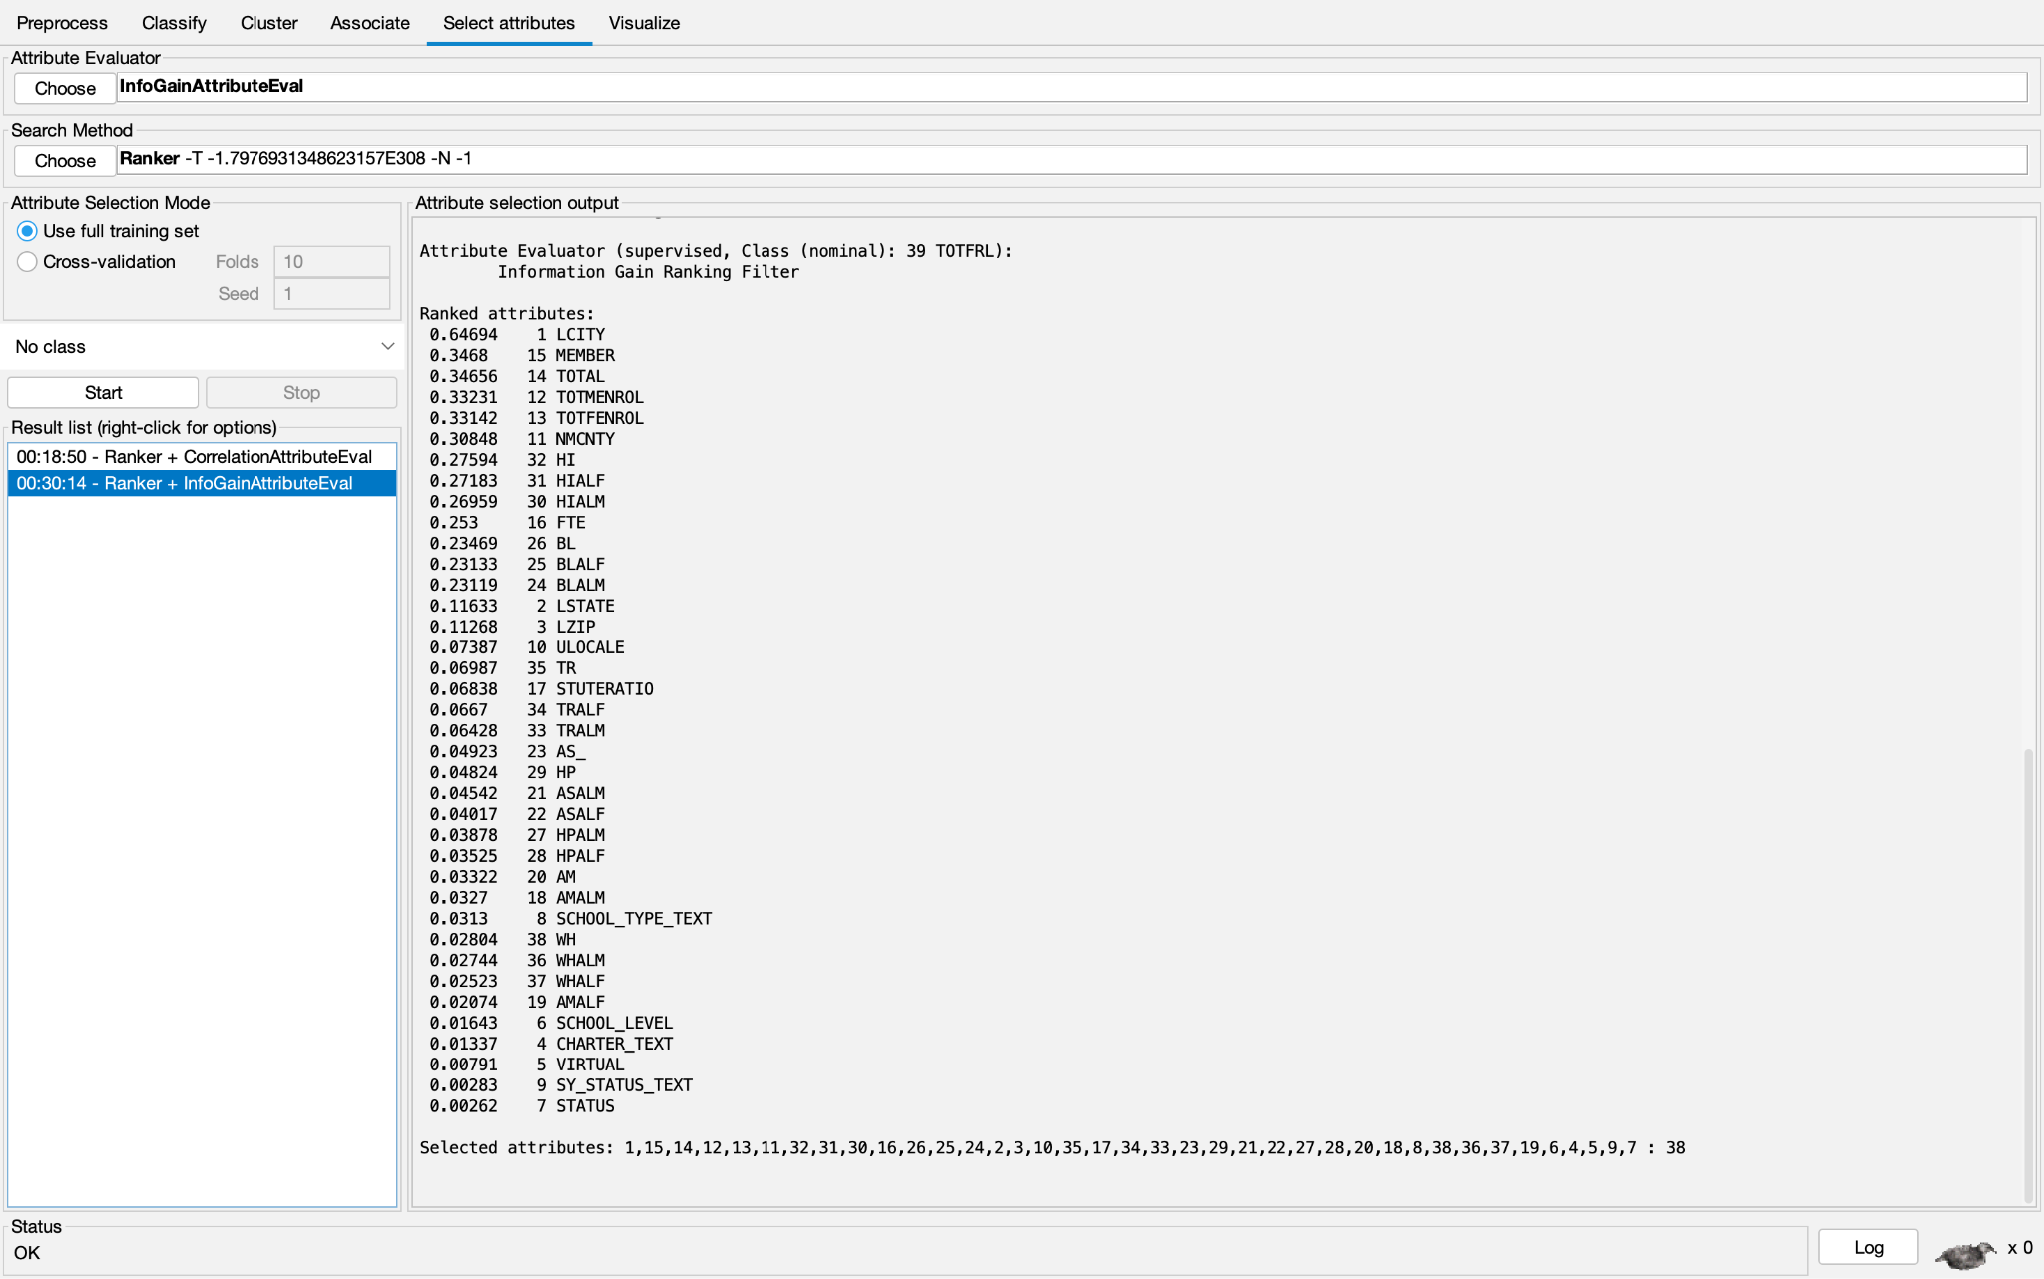
Info Gain
We used Weka’s info gain attribute evaluator with the ranker search method.
We used a cutoff value of 0.2
The attributes we removed were: LSTATE, LZIP, ULOCALE, TR, STUTERATIO, TRALF, TRALM, AS_, HP, ASALM, ASALF, HPALM, HPALF, AM, AMALM, SCHOOL_TYPE_TEXT, WH, WHALM, WHALF, AMALF, SCHOOL_LEVEL, CHARTER_TEXT, VIRTUAL, SY_STATUS_TEXT, and STATUS.
The attributes with an info gain greater than 0.2 were: LCITY, MEMBER, TOTAL, TOTMENROL, TOTFENROL, NMCNTY, HI, HIALF, HIALM, FTE, BL, BLALF, and BLALM.
Infogain is a measure of how well a variable reduces the entropy of another variable, calculated by the equation
InfoGain(Class, Attribute) = H(Class) - H(Class | Attribute).
Notes:
parasmai

Slide 10
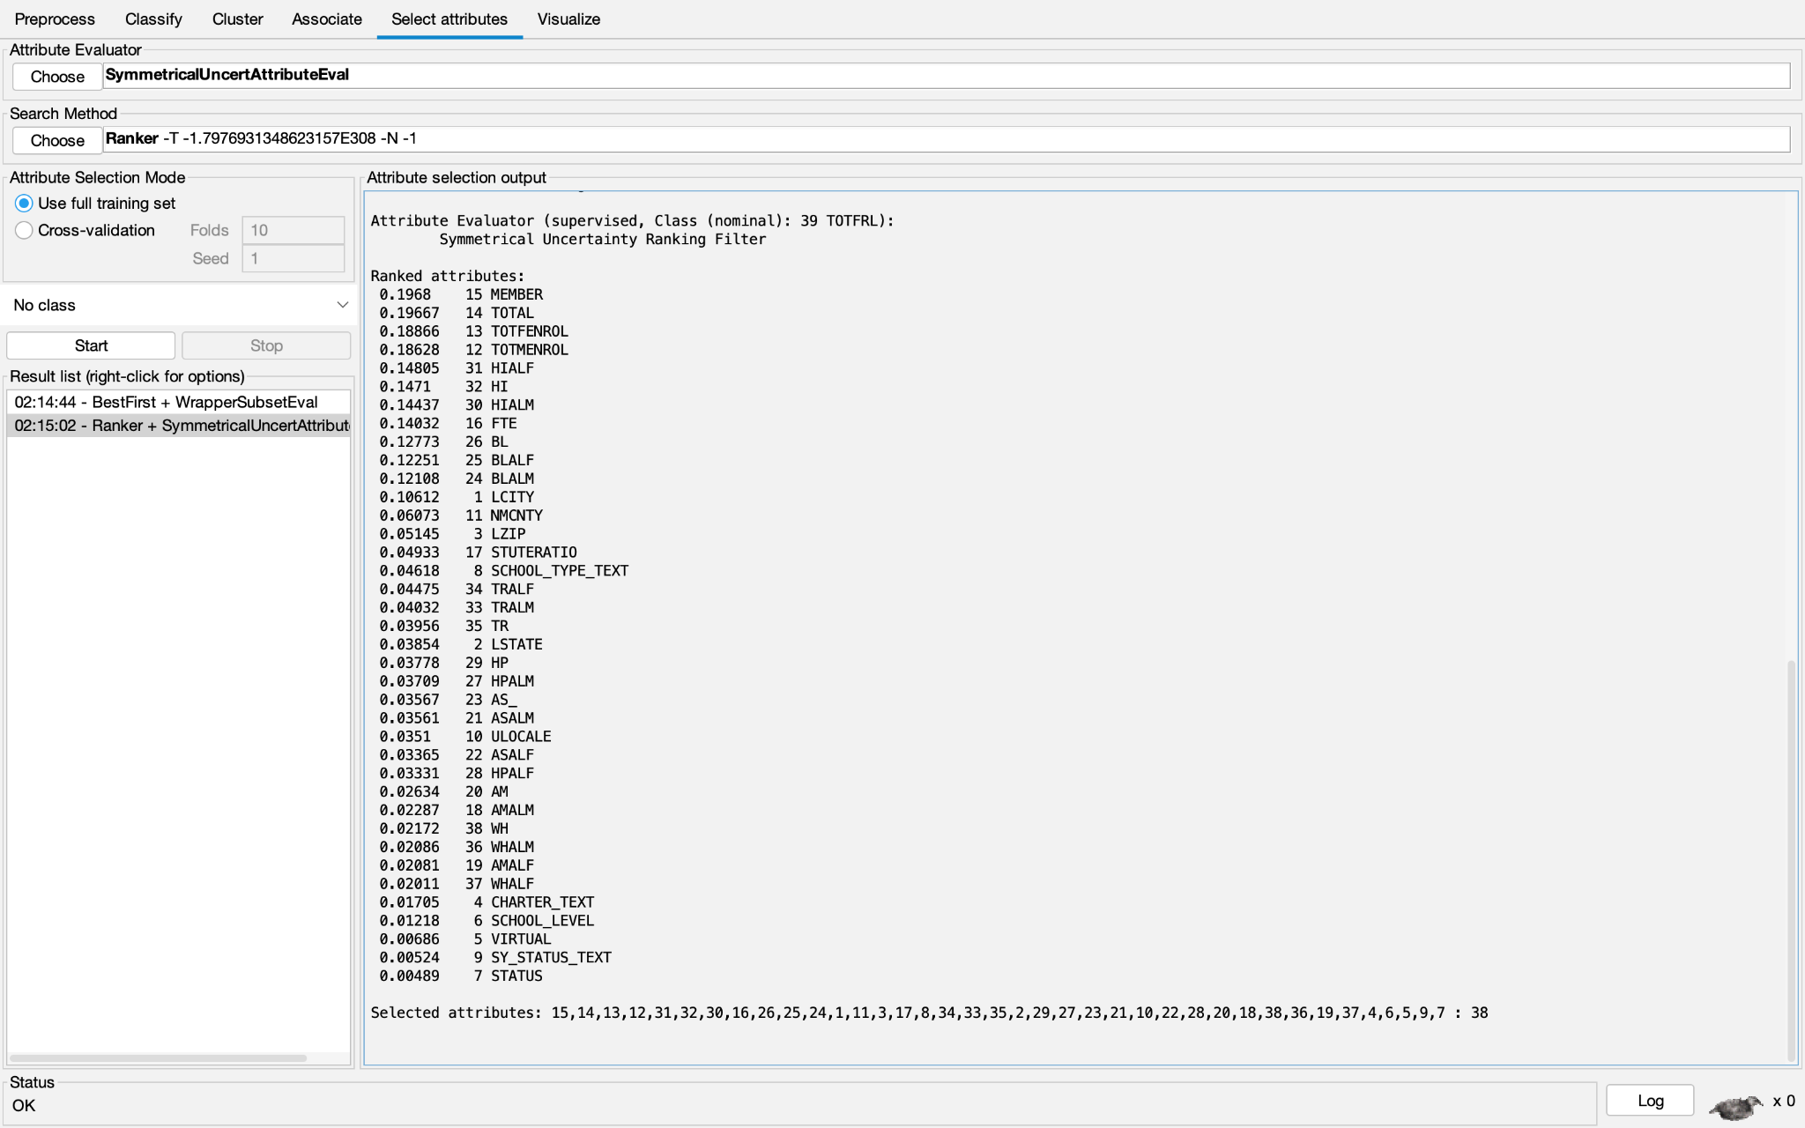
Symmetrical Uncertainty
used a cutoff value of 0.1
the attributes removed were: NMCNTY, LZIP, STUTERATIO, SCHOOL_TYPE_TEXT, TRALF, TRALM, TR, LSTATE, HP, HPALM, AS_, ASALM, ULOCALE, ASALF, HPALF, AM, AMALM, WH, WHALM, AMALF, AMALF, WHALF, CHARTER_TEXT, SCHOOL_LEVEL, VIRTUAL, SY_STATUS_TEXT, and STATUS.
The attributes with a symmetrical uncertainty value greater than 0.1 were: MEMBER, TOTAL, TOTFENROL, TOTMENROL, HIALF, HI, HIALM, FTE, BL, BLALF, BLALM, and LCITY.
Notes:
parasmai

Slide 11
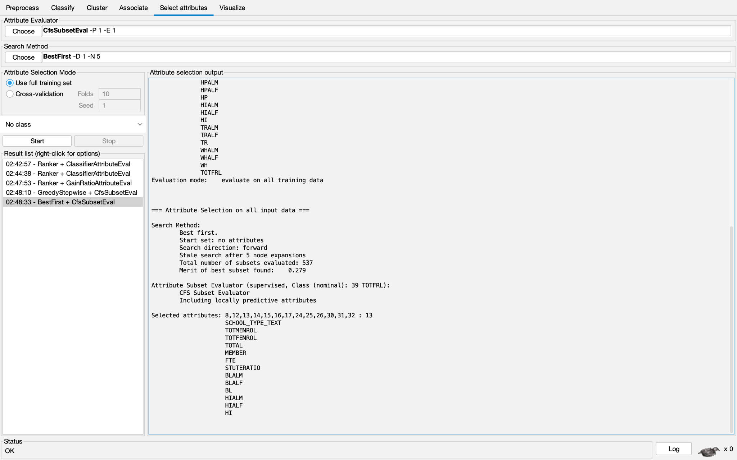
Cfs Subset
Attributes kept: SCHOOL_TYPE_TEXT, TOTMENROL, TOTFENROL, TOTAL, MEMBER, FTE, STUTERATIO, BLALM, BLALF, BL, HIALM, HIALF, and HI.
CfsSubsetAttributeEval evaluates attributes by how correlated they are with the class, while also attempting to avoid selecting attributes highly correlated with each other
Notes:
parasmai

Slide 12
Intuition
Using our intuition. We considered how heavily we thought attributes might be related to the class.
Picked the following attributes: LSTATE, LZIP, SCHOOL_LEVEL, ULOCALE, NMCITY, TOTAL, STUTERATIO, AM, AS_, BL, HP, HI, TR, and WH.
All other attributes were removed.

Slide 13
Classification
NaiveBayes
Probability
Assumes all attributes are independent
J48
Weka C4.5
Information entropy
For each attribute a, find normalised info gain ratio
Create a node that splits based on attribute with highest info gain
Recur
1R
Single rule
Random Tree
Decision tree with k randomly chosen attributes at each node
Notes:
parasmai

Slide 14
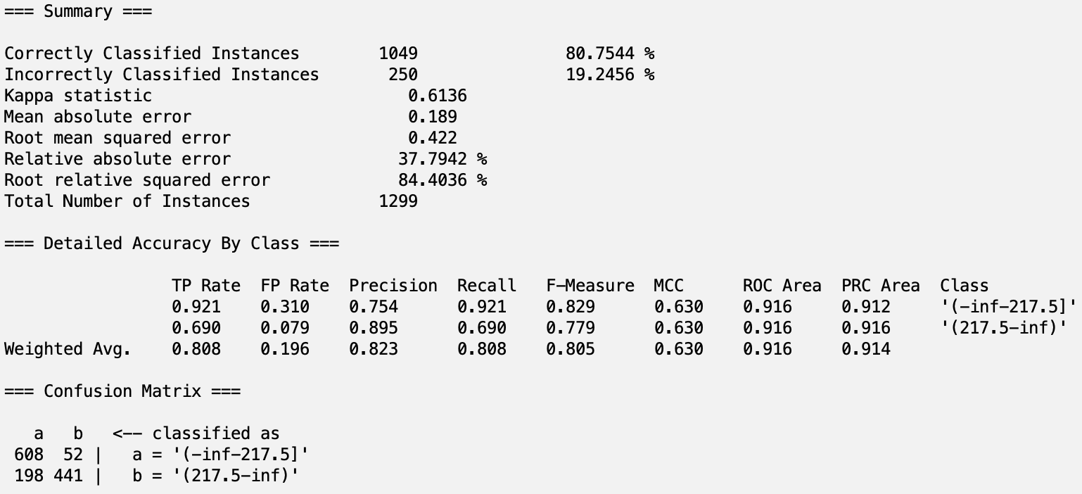

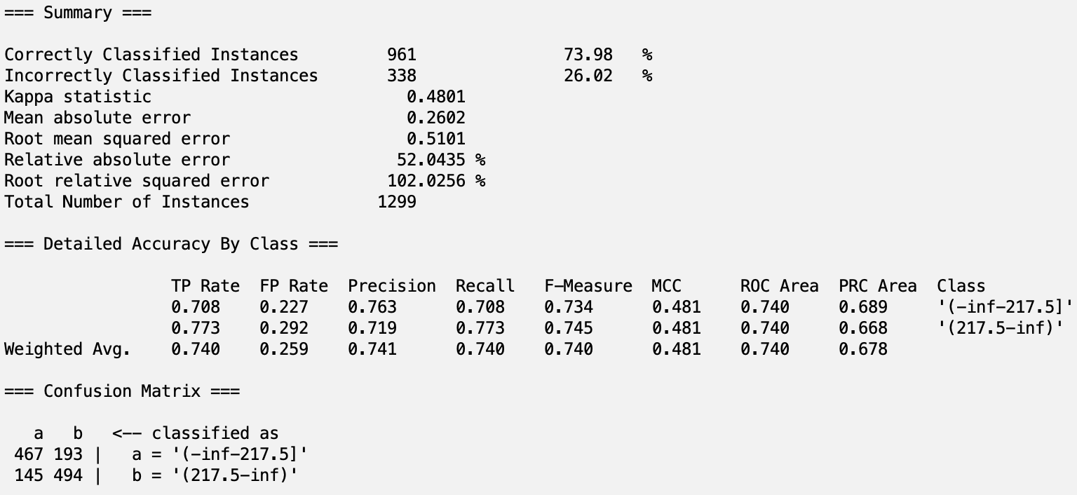

Classification - CorrelationAttributeEval
Naive Bayes : Training accuracy was ~81%, validation accuracy was ~79%
J48: Training accuracy was ~88%, validation accuracy was ~84%
1R: Training accuracy was ~79%, validation accuracy was ~74%
Random Tree: Training accuracy was ~100%, validation accuracy was ~80%
Notes:
lucas

Slide 15
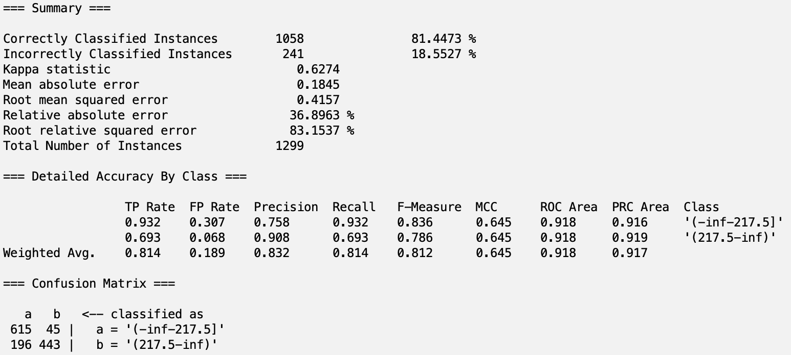
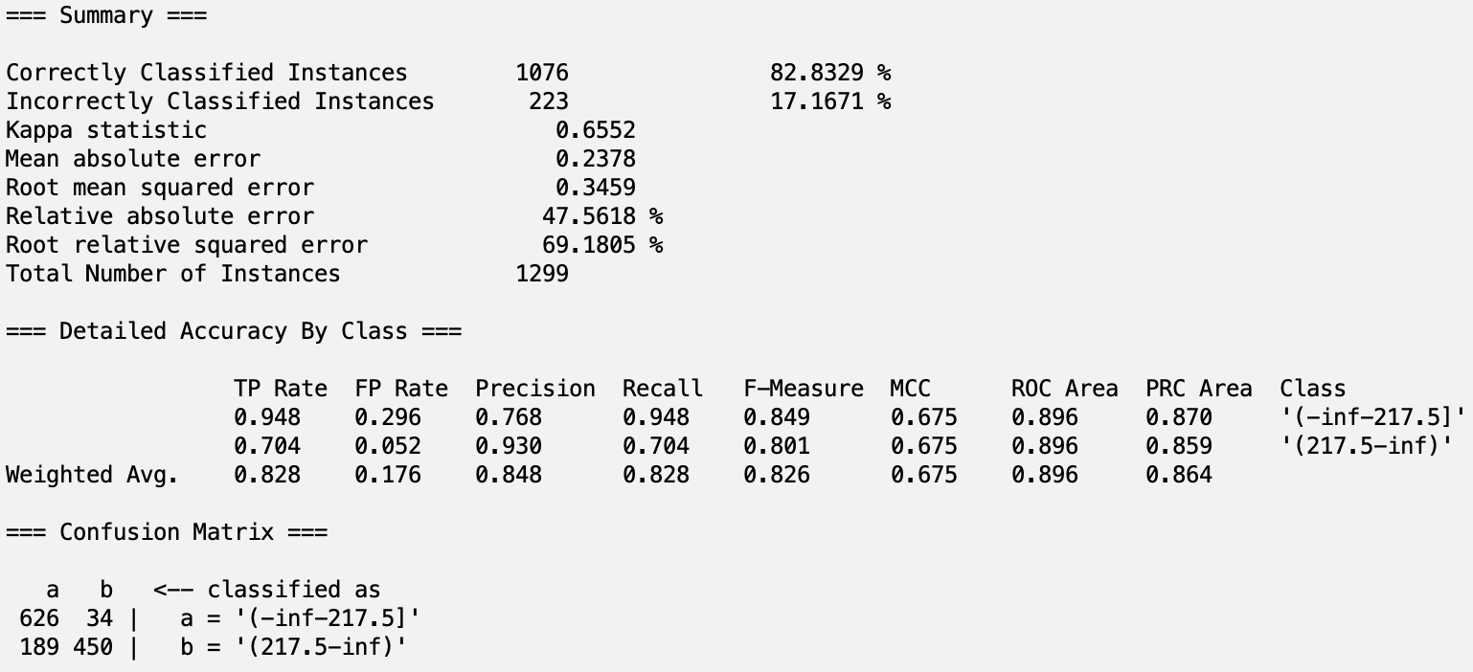
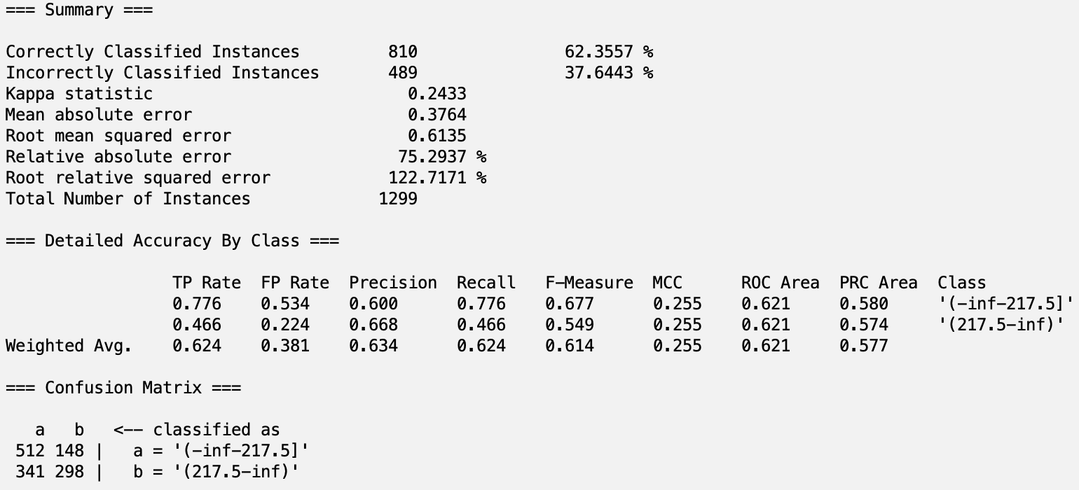
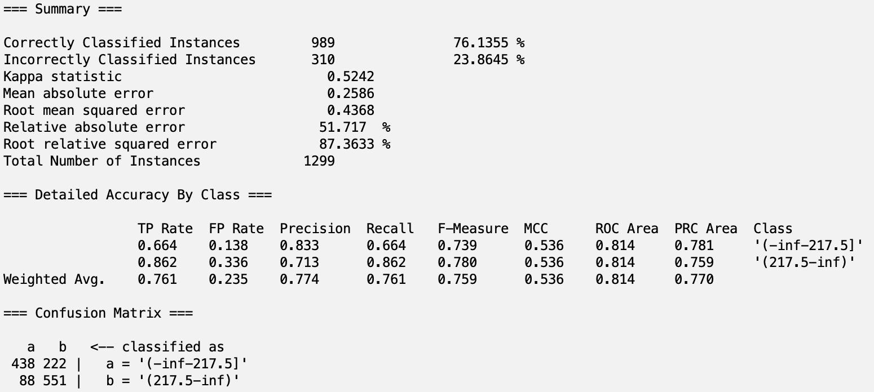
Classification - Info Gain
NaiveBayes: Training accuracy was ~82%, validation accuracy was ~80%
J48: Training accuracy was ~82%, validation accuracy was ~82%
1R: Training accuracy was ~86%, validation accuracy was ~63%
Random Tree:Training accuracy was ~100%, validation accuracy was ~76%
Notes:
lucas

Slide 16
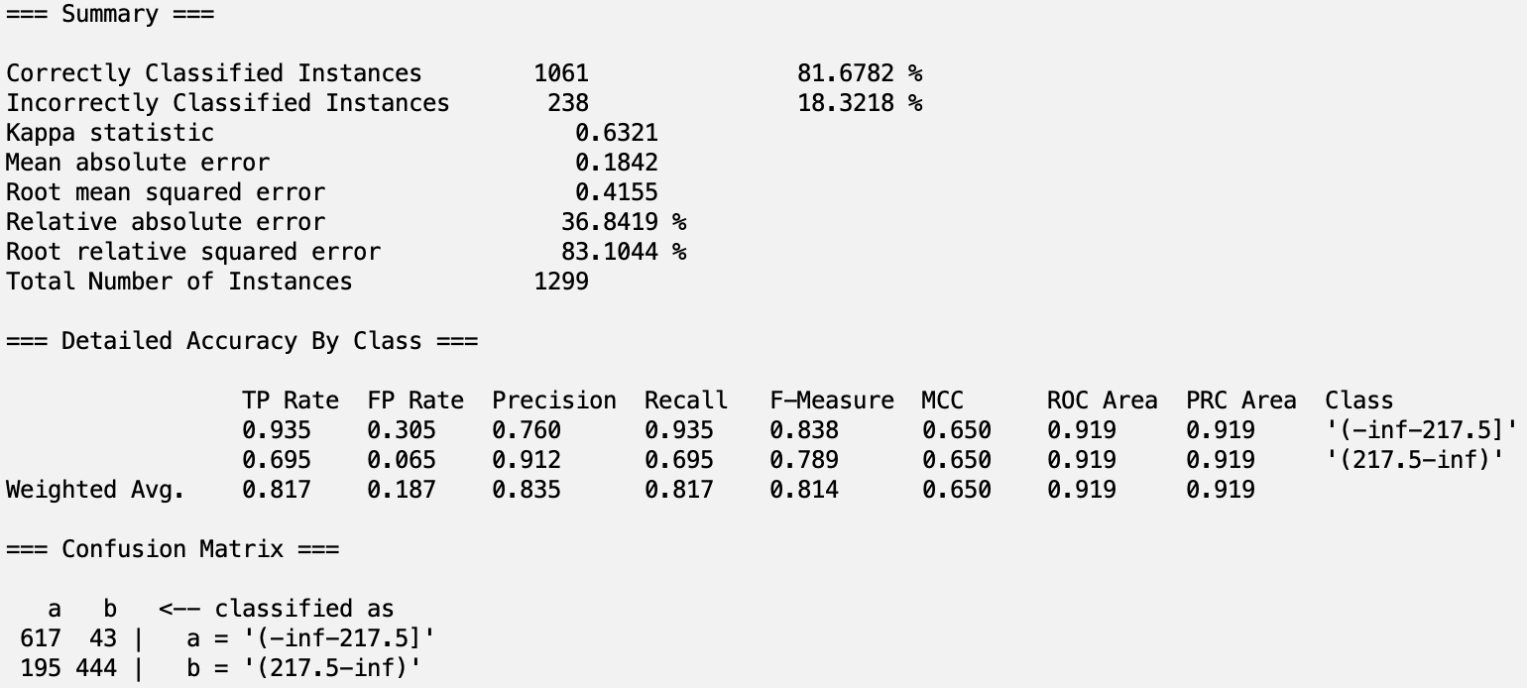

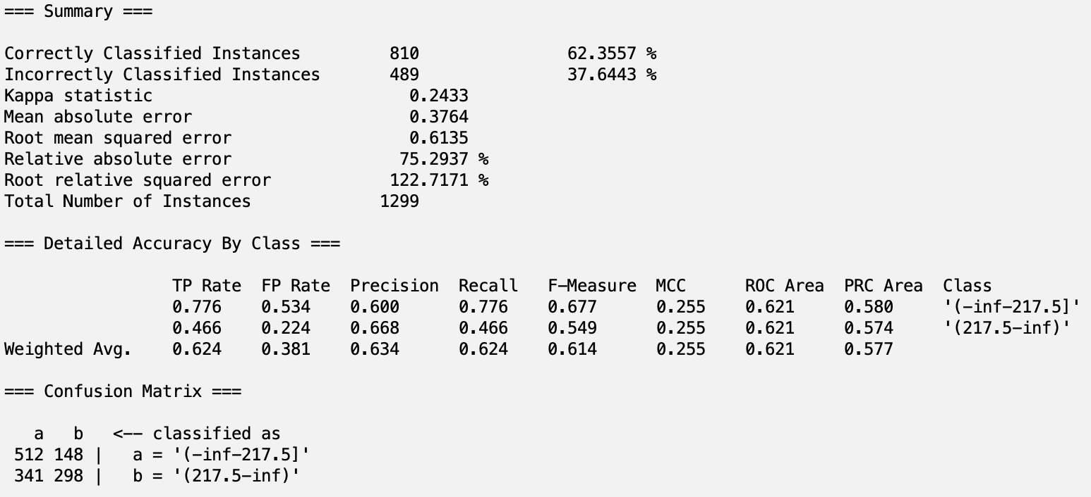
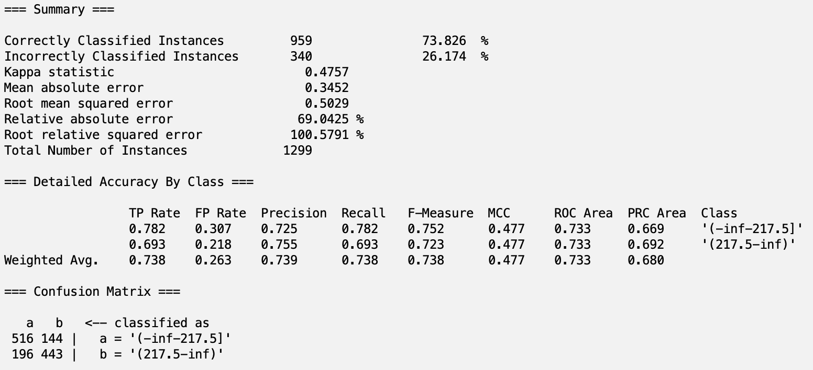
Classification - SymmetricalUncertAttributeEval
NaiveBayes: Training accuracy was ~81%, validation accuracy was ~80%
J48: Training accuracy was ~83%, validation accuracy was ~82%
1R: Training accuracy was ~86%, validation accuracy was ~64%
Random Tree:Training accuracy was ~100%, validation accuracy was ~75%
Notes:
lucas

Slide 17

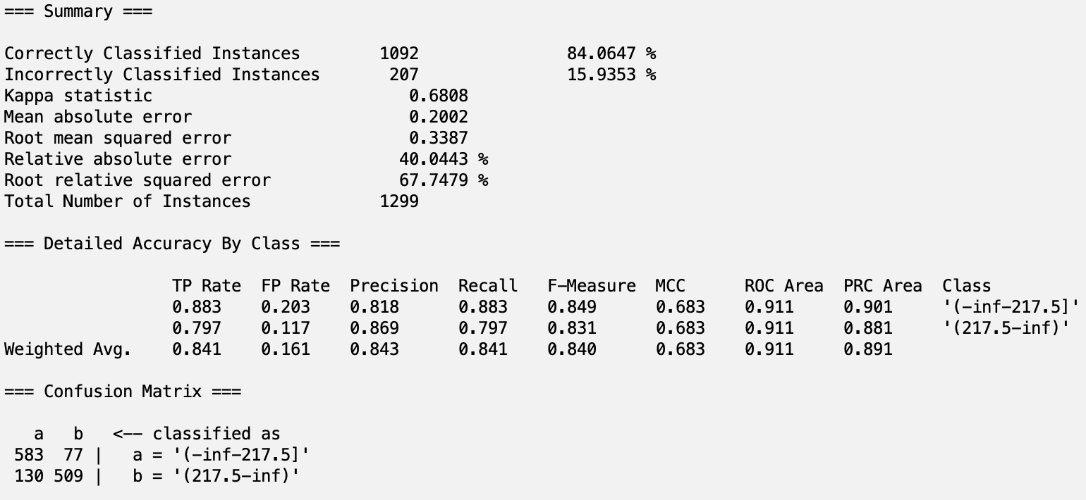
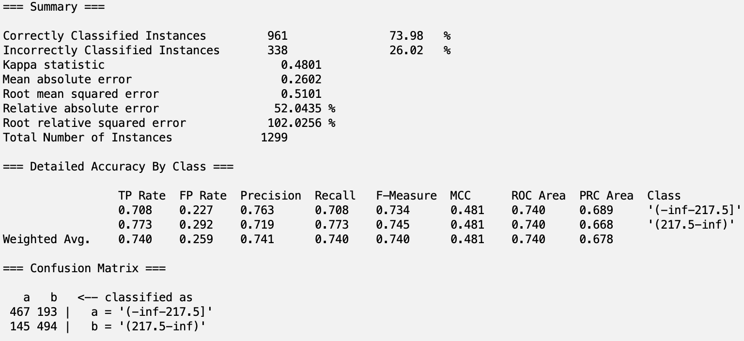

Classification - CfsSubsetAttributeEval
NaiveBayes: Training accuracy was ~81%, validation accuracy was ~80%
J48: Training accuracy was 88%, validation accuracy was ~84%
1R: Training accuracy was ~79%, validation accuracy was ~74%
Random Tree: Training accuracy was ~100%, validation accuracy was ~80%
Notes:
lucas

Slide 18


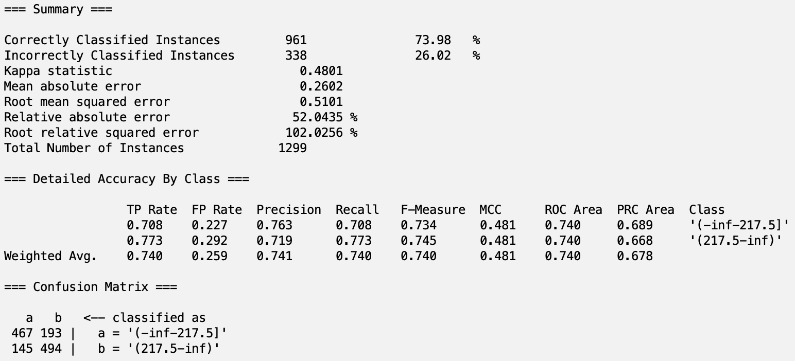
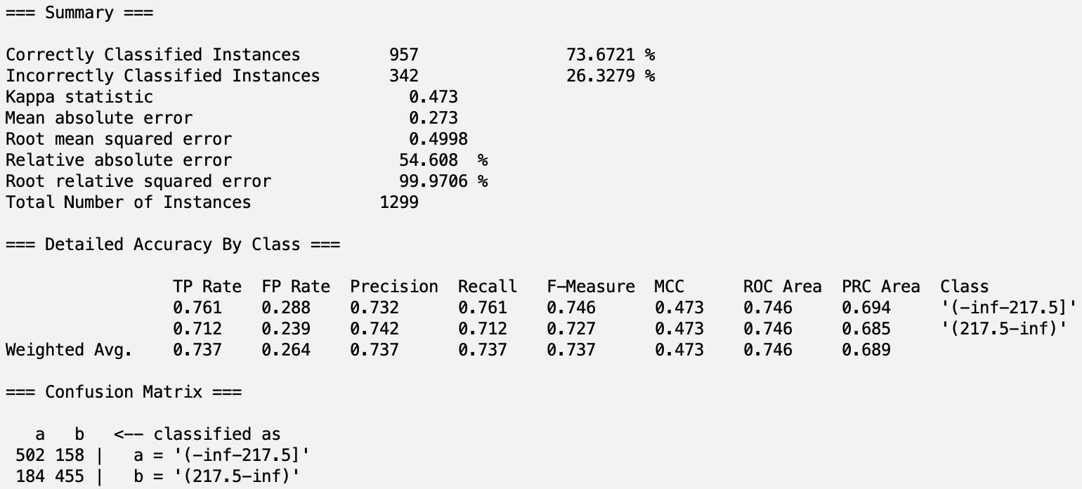
Classification - Intuition
NaiveBayes: Training accuracy was ~80%, validation accuracy was ~80%
J48: Training accuracy was 84%, validation accuracy was ~84%
1R: Training accuracy was ~79%, validation accuracy was ~74%
Random Tree: Training accuracy was ~100%, validation accuracy was ~75%
Notes:
lucas

Slide 19
Analysis
Random Trees can be seen overfitting (100% on training data, then worse from other models on testing)
Best Model in terms of accuracy on testing and training was J48 in Intuition, CfsSubsetAttributeEval, and CorrelationAttributeEval and 1R in SymmetricalUncertAttributeEval
J48 better perform than 1R
Best Model in terms of ROC area is CfsSubsetAttributeEval with NaiveBayes with value of 0.921
Best Model in terms of F-score is J48 in both CorrelationAttributeEval and CfsSubsetAttributeEval with value of 0.84
Notes:
parasmai

Slide 20
Conclusion
Issues:
Dataset was originally too large to just run classifying
Lots of missing values in our attributes, reducing the amount of data availabe
Unable to run PCA
Areas for improvement:
Running more classification models to get a better understanding of our attributes
Training accuracy can be improved by increasing representation of all of our different attributes
Discretize data into more categories

